Slide 1
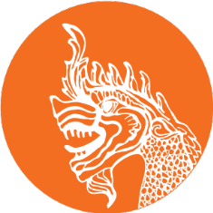

CPWF-Mekong: An introduction
Kim Geheb, CPWF-Mekong Basin Leader

Slide 2
The Mekong River Basin
Area: 795,00 km²
Shared by China (21%), Laos 25%), Burma (3%), Thailand (23%, Cambodia (20%) and Vietnam (8%).
Length: 4,909 km.
Discharge: 457 km³ (China 16%, Burma 2%, Laos 35%, Thailand 18%, Cambodia 18%, Vietnam 11%).

Slide 3
Major SEA Basins
Notes:
SEA = South East Asia

Slide 4
MRB profile
Notes:
MRB = Mekong River Basin

Slide 5
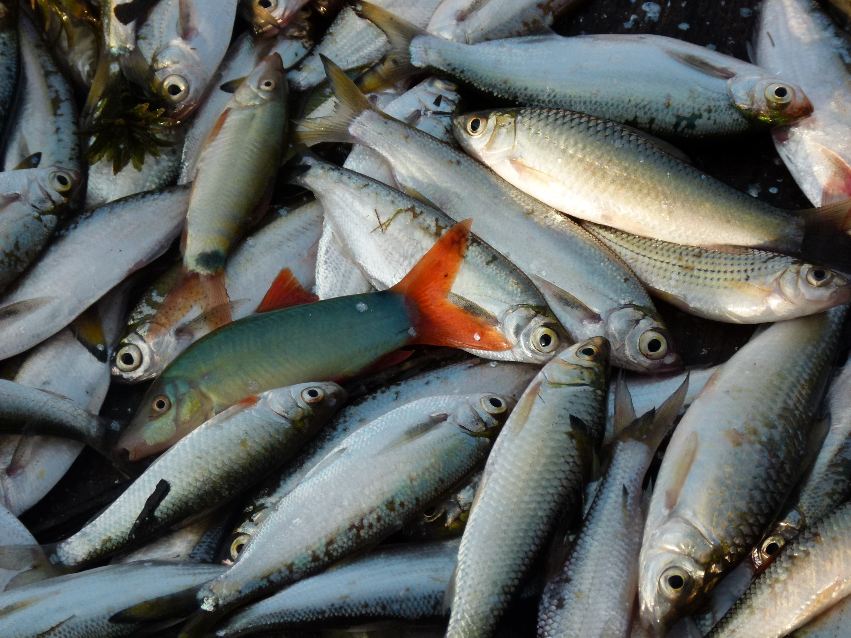
The Tonle Sap and basin fisheries
World’s 2nd most diverse.
Engages +/- 40 million people.
2 million m.t. landed annually.
500,000 m.t. OAAs annually.
2 million m.t. aquaculture.
Notes:
m.t. = Metric tons
OAA = Other Aquatic Animals

Slide 6
MRB Hydropower Potential
LMB= 30,000 MW.
UMB = 28,930 MW
In LMB more than 3,235 MW has been met.
3,209 MW currently under construction.

Slide 7

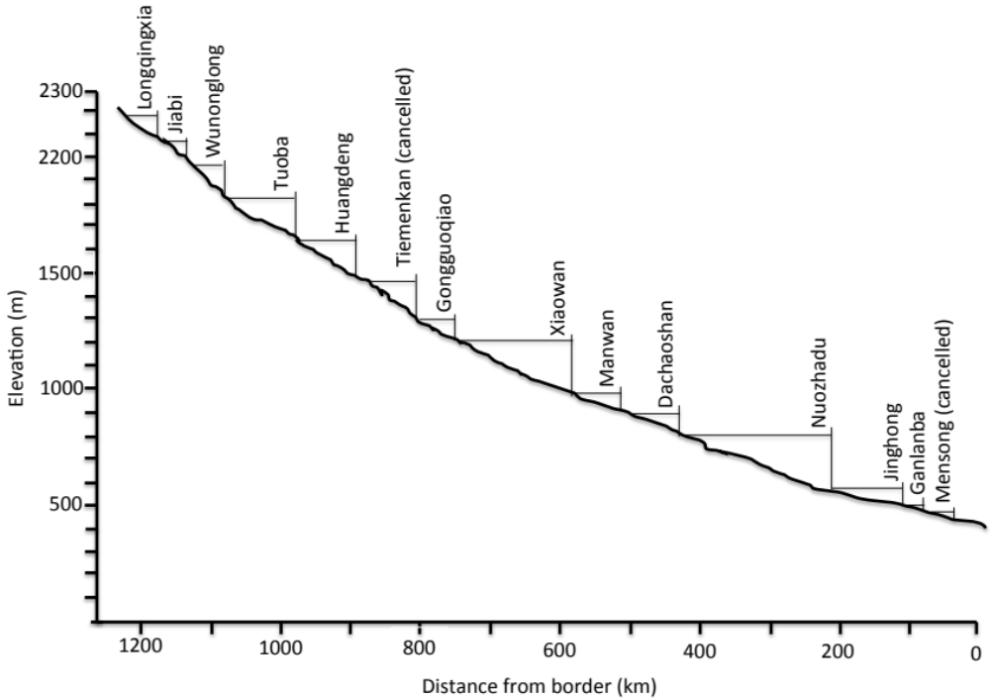
The Lancang Cascade

Slide 8
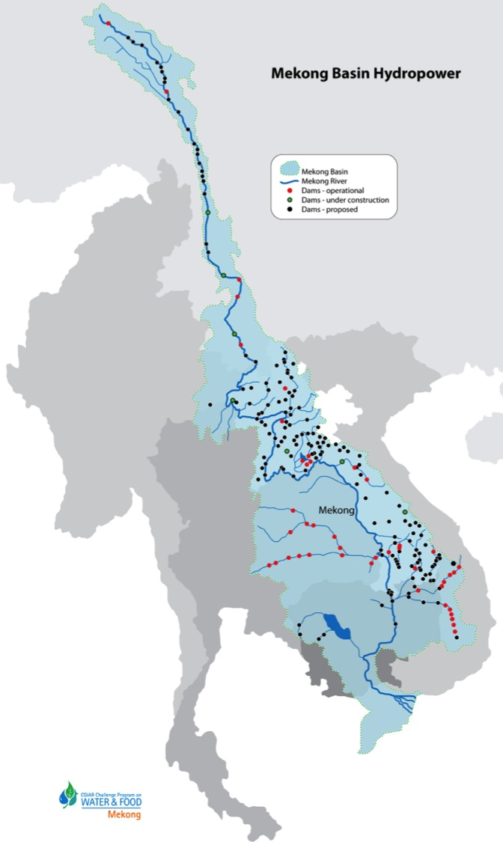
Hydropower development in the Mekong River Basin
≈ 158 dams.
Country | Commissioned | Construction | Planned | Totals
Cambodia | 0 | 2 | 11 | 13
China | 7 | 7 | 8 | 22
Laos | 17 | 14 | 69 | 100
Myanmar | 0 | 0 | 1 | 1
Thailand | 8 | 0 | 0 | 8
Vietnam | 14 | 0 | 0 | 14
Notes:
About 186 dams are commissioned, under construction or planned for the basin. This is an estimate, because not all planned projects will necessarily be started. Data best for Laos, Cambodia, Vietnam and Thailand. Hydropower potential in Thailand is high, but local resistance to dam construction is a significant impediment to further expansion of hydropower capacity. This is not a problem in Laos, where low population densities, high hydropower potential and relatively authoritarian government are all attractions to developers. Vietnam has more or less fully exploited its technically feasible hydropower potential in the Vietnamese Highlands. China’s topography makes it suitable for very large dams. The recently completed Xiaowan is the world’s tallest arch dam; the Rumei Dam, if it goes ahead, would be the world’s tallest dam at 315 m.

Slide 9
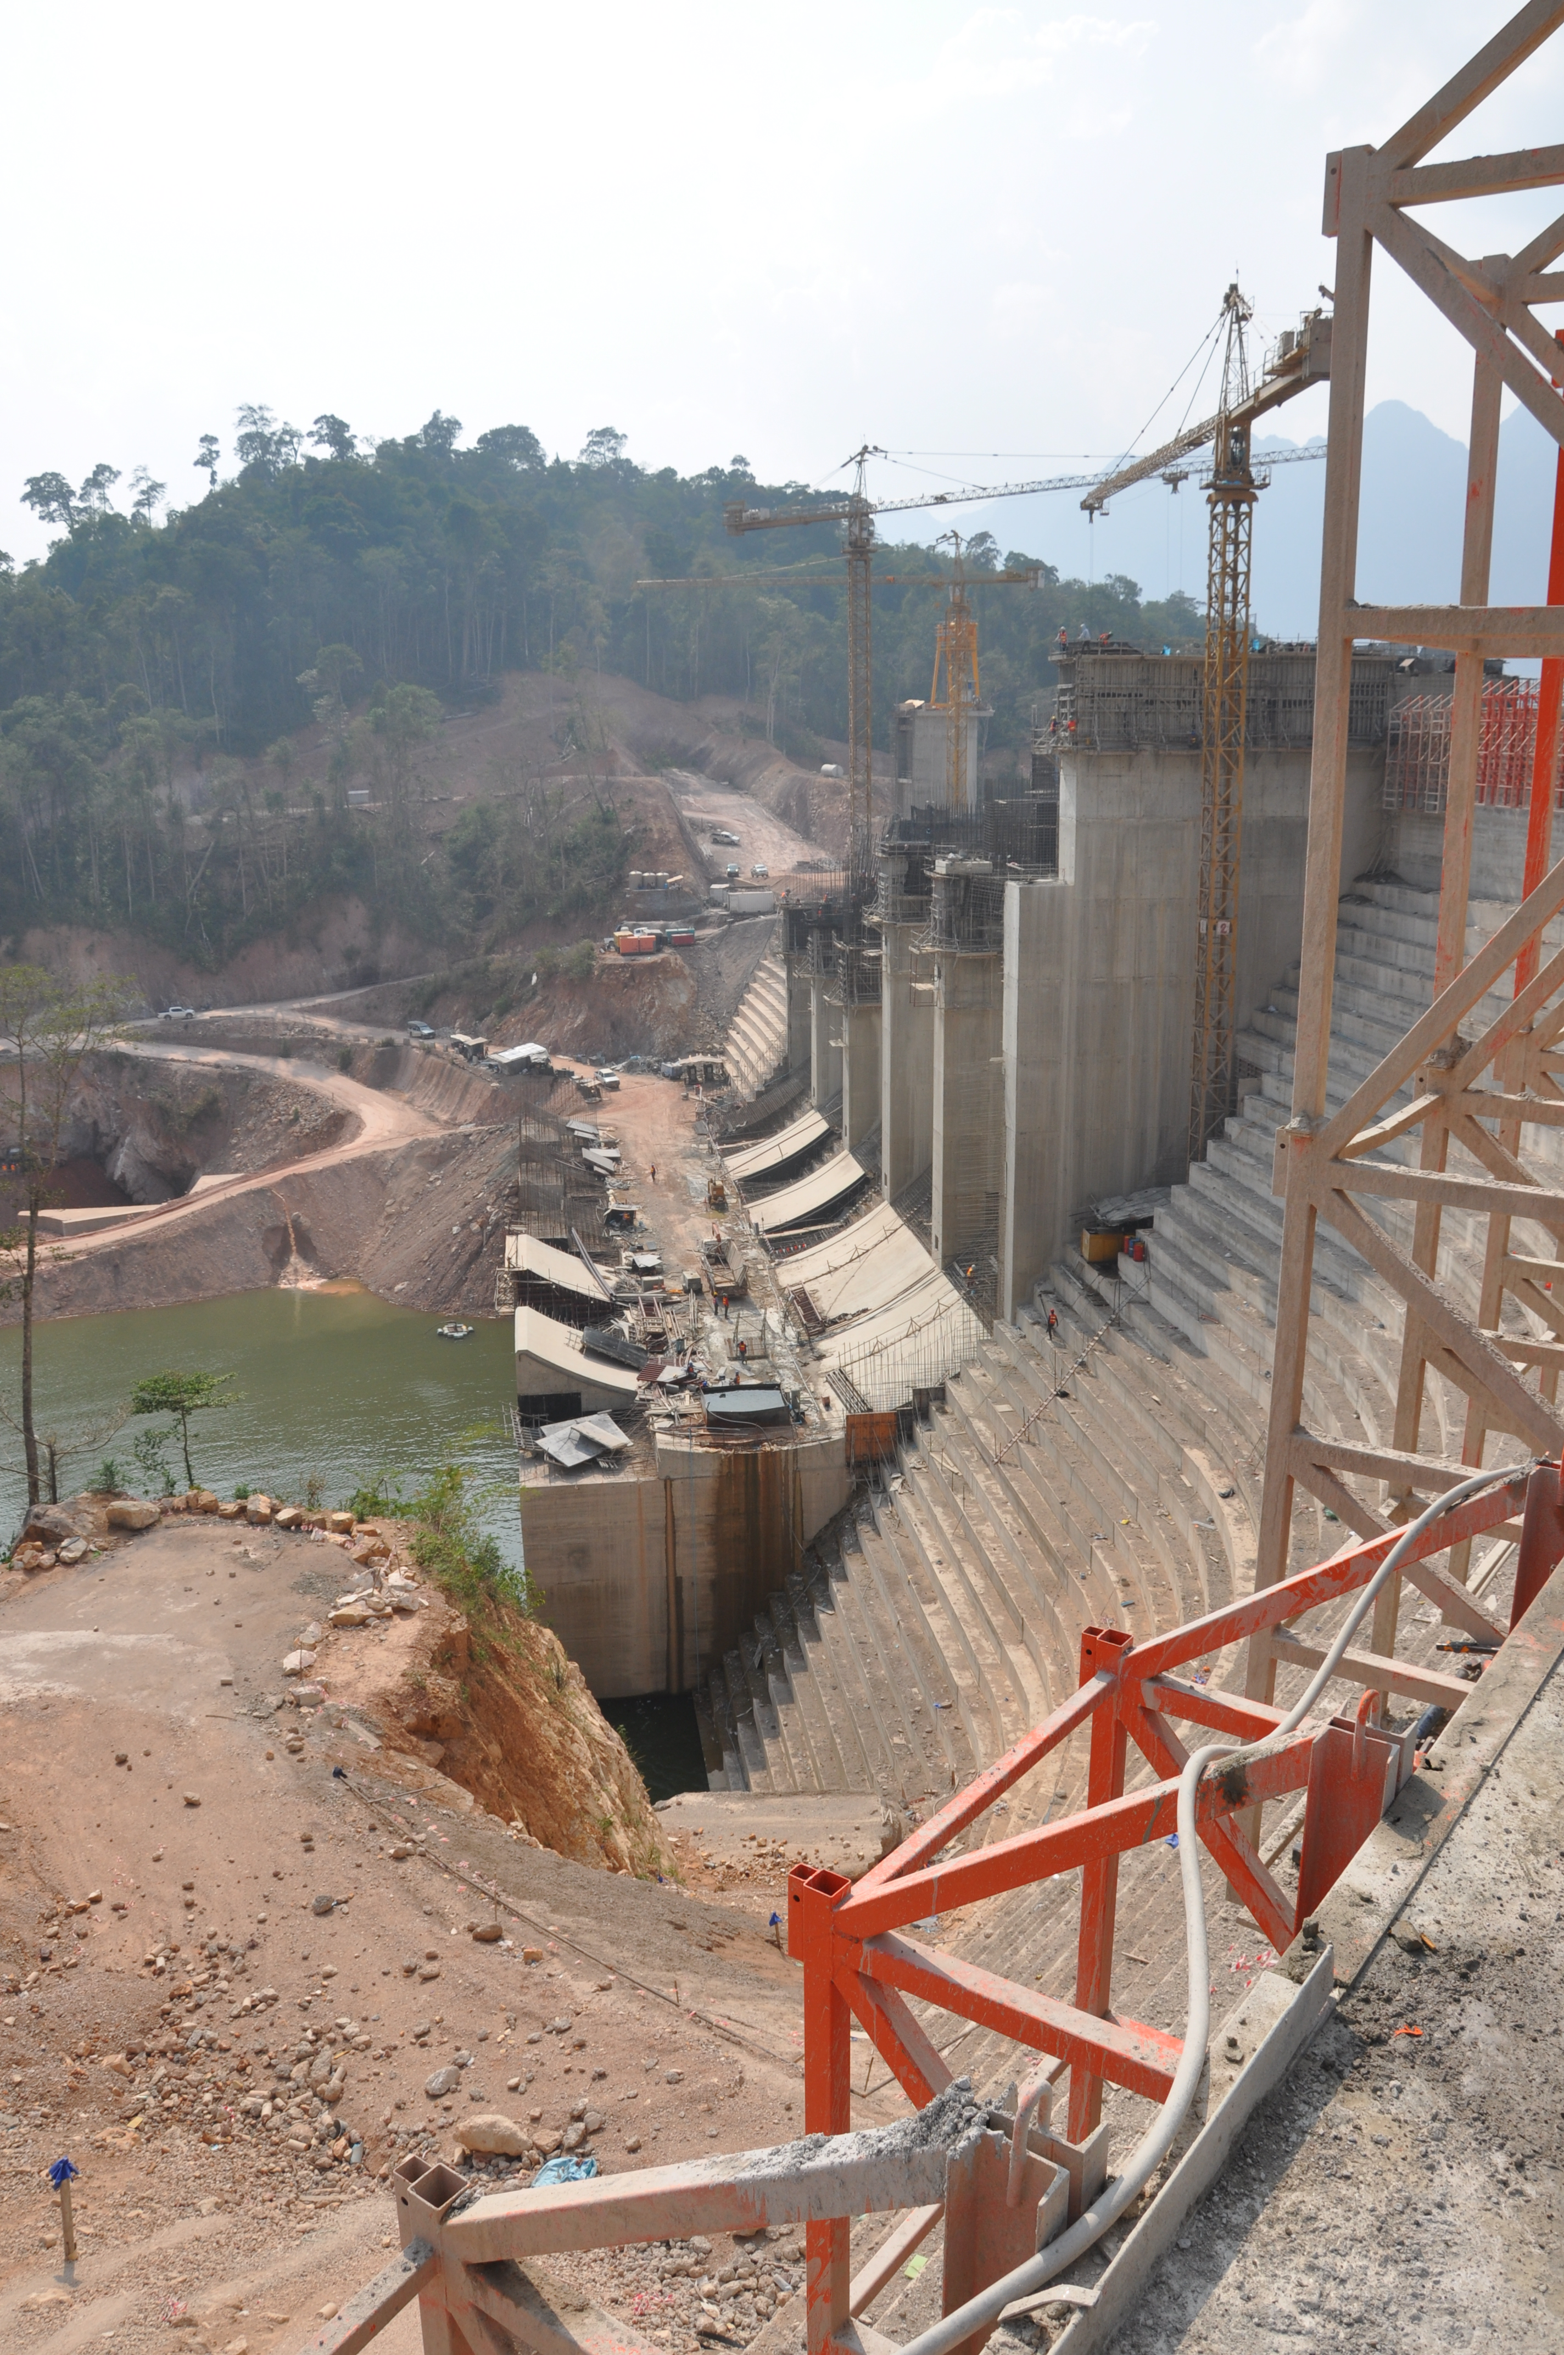
CPWF-Mekong
To reduce poverty and foster development by optimizing the use of water in reservoirs

Slide 10
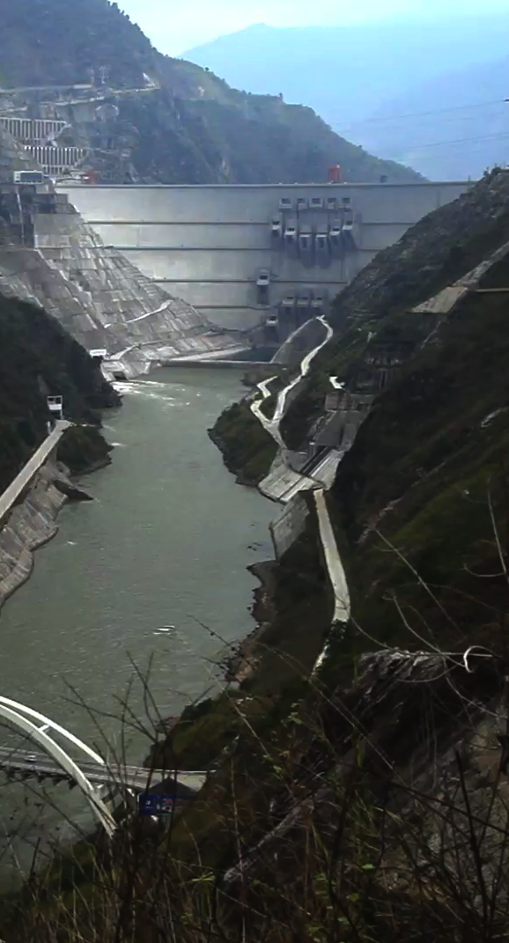
If we’re successful, then…
Reservoirs will:
Be managed in ways that are fairer and more equitable to all water users.
Be managed and coordinated across cascades to optimize benefits for all.
Be planned and managed to account for environmental and social needs.
Be used for multiple purposes.
Be better governed and the benefits better shared..

Slide 11
CPWF-Mekong - basics
US$10.8 million investment
Funded by AusAID and CPWF Core Funds.
Works in China, Lao PDR, Vietnam, Thailand, Cambodia.
62 Formal partners.
≈140 informal partners.
7 MOUs or letters of association.
19 diverse projects implemented across the region.

Slide 12

Key issues that we address
Low levels of CSR, standards & guidelines.
Serious resettlement challenges.
Low levels of innovation adoption – technical & managerial.
Poor regulation & weak institutions.
Opaque decision-making.
Secret EIAs/SIAs
Confused/non-existent governance.
Major trans-boundary dimensions.

Slide 13
Strategies
Research for development projects.
Partnerships – diversity.
Convening power.
Communications – engagement – dialogues.
Base | %
International | 9
Thailand | 12
Cambodia | 28
Vietnam | 18
Lao PDR | 26
China | 5
Regional | 2
Type | %
Consultancy | 5
Government Agency | 23
Government Research Institute | 7
Independent Research Institute | 5
Network | 5
NGO | 26
University | 28
62 Partners

Slide 14
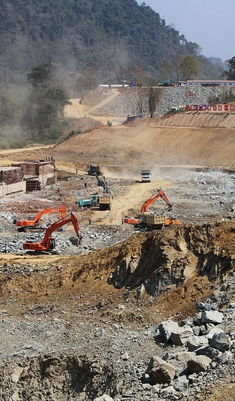
(Emerging) outcomes
HSAP successes in China.
Integrated farming systems in resettlement communities.
Ecological functions for reservoirs.
Improving dam responses to international safeguards.
Two Mekong Forums on Water, Food and Energy.
New sustainable hydropower curricula.
IWRM advances in Cambodia.
Chinese downstream engagement.
Successful convening power/R4D model.

Slide 15
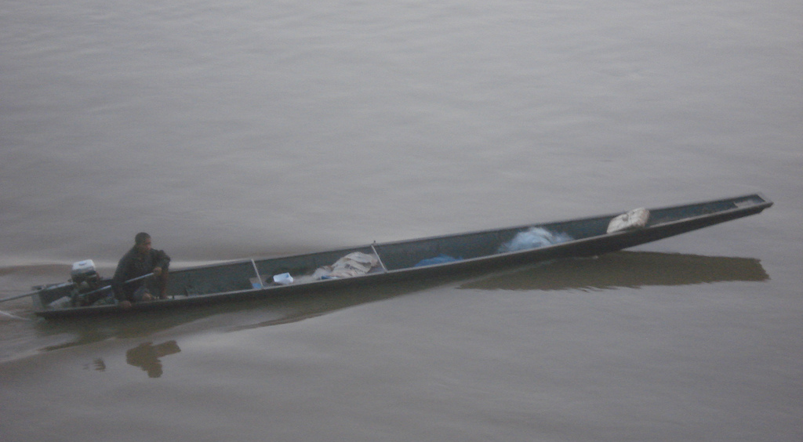
Thanks for listening!

